Slide 1
The Battle of Neighborhoods
Open a Kid’s Mall in Vancouver
Sayali Gholap
June, 2021

Slide 2
Business Problem
Explore optimal neighborhoods to open a kid’s mall.
Finding a kids mall that would suffice all the needs of children is rare. A place that would be convenient especially for parents to buy baby food, clothing, toys, etc. at one stop with no need to travel different places for different requirement.
Stakeholders: Residents of Vancouver especially parents that would get benefit of all the services at one stop.

Slide 3
Data Source
For information related to Vancouver city and its postal codes; web scrapping would be done from List_of_postal_codes_of_Canada:_V [1] Vancouver's neighborhoods along with postal codes would be extracted.
Get location co-ordinates of each postal code using- Geopy [2].
Venue related data such as venue name, type, location, tips via- Foursquare API [3]
Venue types- garden, parks, playground, kids store would be used for analysis
Vancouver city official website [4]

Slide 4
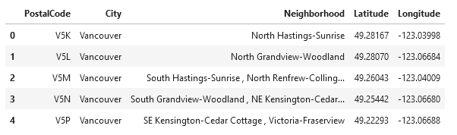
Methodology- Web scrapping
Beautiful Soup and Geopy libraries are used to extract and create a data frame as below

Slide 5
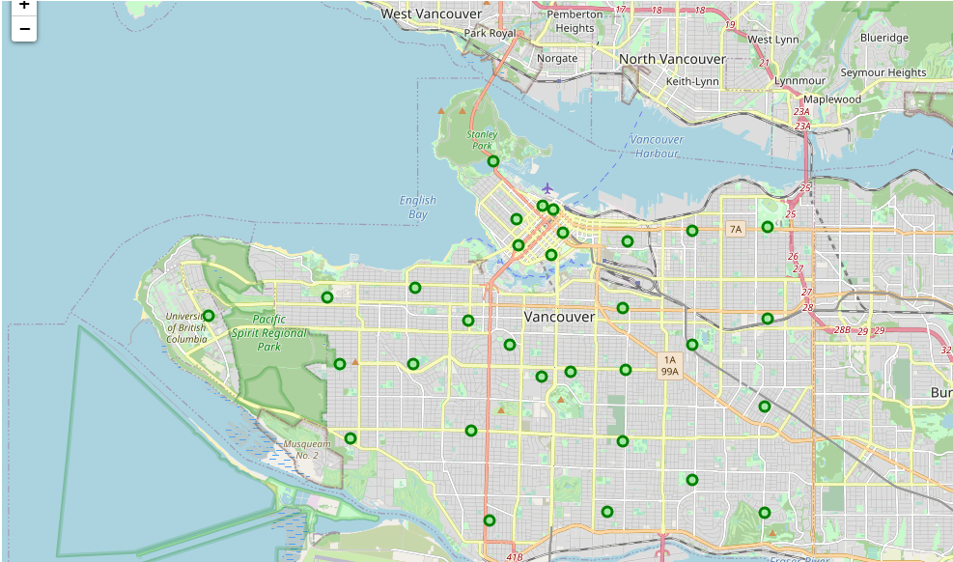
Map to visualise Vancouver’s Neighborhood

Slide 6
Explore Vancouver’s Neighborhood
Data provided by Foursquare API (radius 1000m) -
Total 236 unique venue categories
2039 venues
31 postal codes
The 4 Venue Categories of our interest are-
Park
Playground
Garden
Toy / Game Store

Slide 7
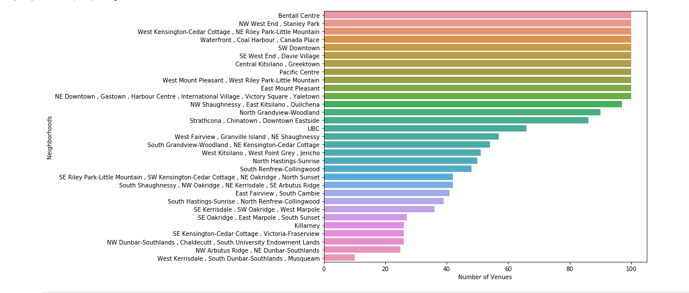
Venues per Neighborhood

Slide 8
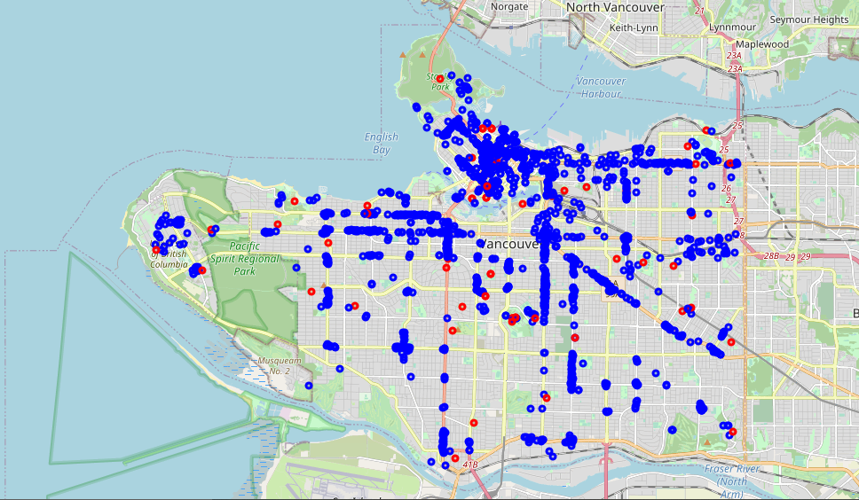
Visualize Venue Categories
Park, Playground, Garden, Toy / Game Store
Rest of the venue categories

Slide 9
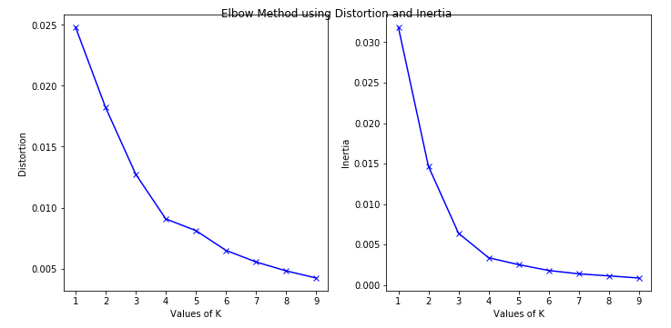
Cluster Neighborhoods Elbow method to determine value of K
Optimal value of K=4

Slide 10
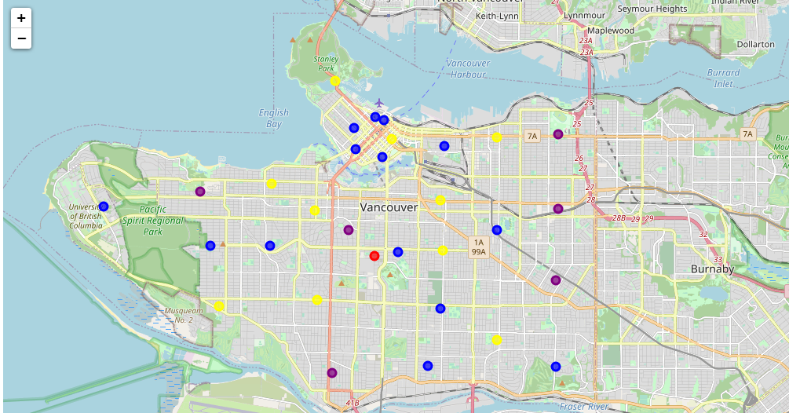
Visualise clustered Neighborhoods
Cluster0
Cluster1
Cluster2
Cluster3

Slide 11
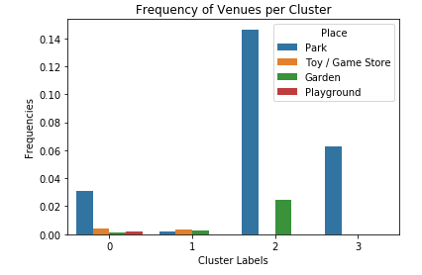
Frequency of Venues per Cluster

Slide 12
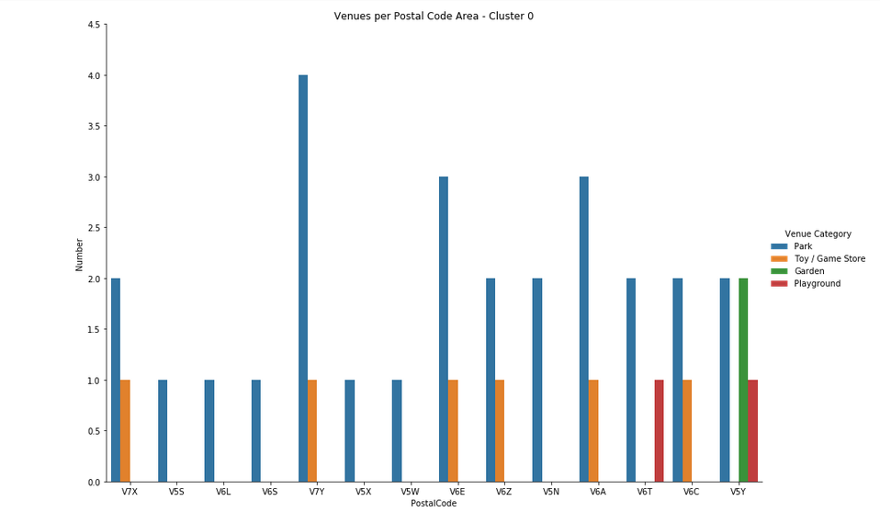
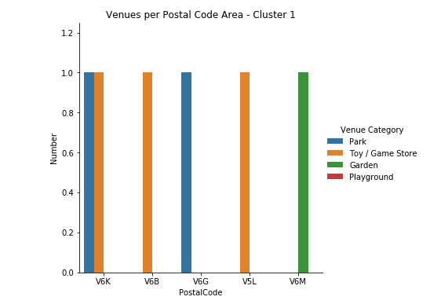
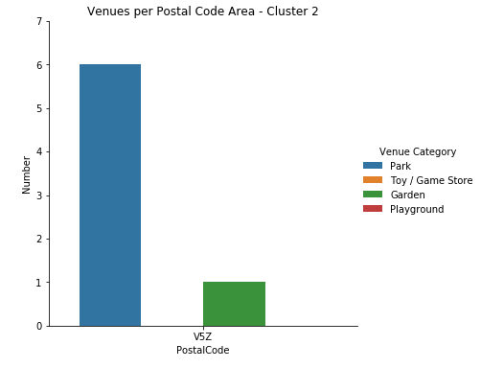
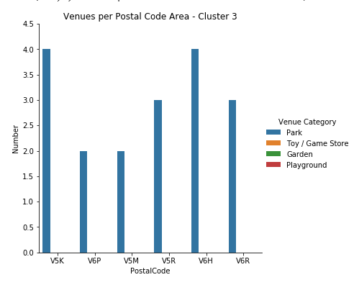
Examine Venues per Postal code for each cluster

Slide 13
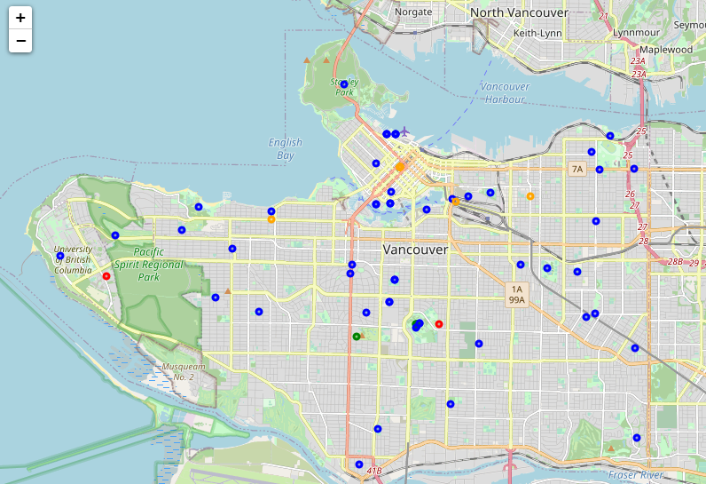
Park
Toy/Game store
Garden
Playground

Slide 14
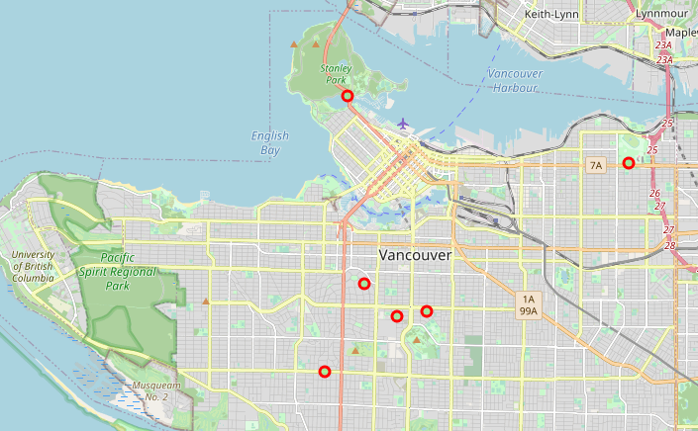
Cluster analysis result
Postal codes found to be optimal post analysis-
V5Y, V6G, V6M, V5Z, V5K and V6H.

Slide 15
Result
Recommend following places to explore to open a new Kid’s Mall-
V5K- North Hastings-Sunrise -> A perfect neighborhood that offers all venues of our interest with no existing competitor (from Cluster0).
V6M- South Shaughnessy , NW Oakridge , NE Kerrisdal -> A residential area with more potential than other neighborhoods in same cluster (from Cluster1)
V5Z- East Fairview , South Cambie -> A new place to explore Kids Mall (from Cluster2)
V5K- North Hastings-Sunrise ->A residential area with many parks attracting more customers to the store (from Cluster3)
V6H- West Fairview , Granville Island , NE Shaughnessy-> A shopping district that would definitely offer customers to Kids Mall (from Cluster3)

Slide 16
Conclusion
In this study, analysis of neighborhoods of Vancouver City is done to explore promising locations to open a Kid’s Mall.
Features like parks, garden, existing kids store/ toy store, playground helped in the analysis of optimal locations. Foursquare API was used to get location details like Venue names, category, etc.
K-means clustering algorithm helped to clusters the neighborhoods into 4 clusters.
Postal codes from each neighborhood were analysed in detail with help of visualization. As a result top 5 locations can be presented to stakeholders to open a new kid’s store.

Slide 17
Resources
[1] List_of_postal_codes_of_Canada:_V - https://en.wikipedia.org/wiki/List_of_postal_codes_of_Canada:_V
[2] Geopy - https://pypi.org/project/geopy/
[3] Foursquare API - https://developer.foursquare.com/
[4] Vancouver city official website - https://vancouver.ca/
[5] Vancouver Wiki- https://en.wikipedia.org/wiki/Vancouve

